Slide 1


SPECIAL ABLED PEOPLE FEEDBACK FORM
IMPROVING ACCESSIBILITY AND USER EXPERIENCE
TEAM SHOURYA

Slide 2
SHOURYA
INTRODUCTION
Welcome to the Feedback Form Application, specifically designed to ensure inclusivity and ease of use for individuals with disabilities. We understand the importance of fostering an environment where everyone’s voice is heard, regardless of their abilities. This innovative application is meticulously crafted to accommodate diverse needs, making the process of providing feedback straightforward and accessible for all.

Slide 3
Problem Statement
SHOURYA
Despite the significant advancements in technology and awareness, there is a notable gap in providing an inclusive and accessible feedback mechanism for individuals with special abilities. The current feedback systems often lack the necessary accommodations to cater to the diverse needs of this demographic, hindering their ability to effectively express their opinions and experiences. The absence of a tailored feedback form that considers various types of disabilities, such as visual, auditory, cognitive, or motor impairments, further exacerbates the issue. There is a pressing need to address this gap and create a specialized feedback form that ensures a seamless and accessible experience for individuals with special abilities. The goal is to develop a platform that takes into account different assistive technologies, communication preferences, and usability requirements to enable this demographic to provide valuable feedback in a user-friendly and inclusive manner.

Slide 4
GCP Components
SHOURYA
Developing a feedback form for individuals with special abilities using Google Cloud Platform (GCP) components involves creating an accessible and inclusive web application.
Here's a high-level guide on how we might approach this using GCP:
Frontend Framework : React
Firebase Hosting for Web Hosting: To provides a fast and secure hosting solution. Firebase Hosting also supports HTTPS, which is crucial for security.
Integrate Cloud Firestore for Data Storage: Cloud Firestore, a NoSQL document database, to store feedback data securely. Firestore offers real-time synchronization and easy scalability.
Authentication with Firebase Authentication: Firebase Authentication to secure the feedback form. Users, including individuals with special abilities, can sign in securely to provide feedback.
Kubernetes as Backend: To validate form submissions, send confirmation emails, or perform other server-side operations.

Slide 5
GCP Components
SHOURYA
6 . Accessibility Features: Google Cloud's Speech-to-Text API to allow users to provide feedback using voice input and Text-to-Speech features for reading out form instructions or confirmation messages.
7. Cloud Vision API for Image Accessibility: Cloud Vision API to make images on the form accessible. This API can be used to generate descriptions for images, benefiting users with visual impairments.
8. Google Cloud Translation API to provide multi-language support for users who speak different languages.
9. Google Analytics: Used to collect user data and gain insights into user interactions. Analyze the data to identify areas for improvement in the form's accessibility.
10. Comply with Accessibility Standards: Feedback form always complies with accessibility standards, such as WCAG (Web Content Accessibility Guidelines), to provide an inclusive experience.

Slide 6
GCP Monitoring
SHOURYA
Google Cloud Platform (GCP) provides a variety of monitoring and observability tools to help users track the performance, health, and availability of their applications and infrastructure.
Here are some key monitoring tools available in GCP:
Google Cloud Monitoring: Google Cloud Monitoring is a comprehensive monitoring solution that allows us to collect, analyze, and visualize metrics from our GCP resources and applications.
Key Features: Dashboards and charts for visualizing metrics. Alerting policies to notify based on defined conditions. Integration with other GCP services.
2.Google Cloud Logging: It helps us to capture and store logs from our applications and infrastructure, allowing us to analyze and troubleshoot issues.
Key Features: Centralized logging for GCP resources. Real-time log analysis. Integration with Cloud Monitoring.

Slide 7
GCP Monitoring
SHOURYA
3.Google Cloud Trace: Google Cloud Trace allows us to collect latency data from our applications, helping us to understand and optimize performance.
Key Features: Trace API for custom instrumentation. Integration with other GCP services. Performance insights for web applications.4.
4.Google Cloud Debugger: It enables us to inspect the state of our applications in production without affecting performance.
Key Features: Snapshot-based debugging. Minimal impact on application performance. Integration with various programming languages.
5.Google Cloud Profiler: It helps us to understand the resource consumption of our applications by providing statistical data about CPU and memory usage.
Key Features: Continuous profiling to capture resource consumption over time. Low-overhead instrumentation. Integration with various programming languages.

Slide 8
GCP Monitoring
SHOURYA
6.Google Cloud Operations Suite (formerly Stackdriver): It is a suite of tools for managing, diagnosing, and troubleshooting applications.
Key Features:
Monitoring: Collecting and visualizing metrics.
Logging: Storing and analyzing logs.
Error Reporting: Detecting and analyzing errors.
7.Error Reporting: It automatically collects and aggregates errors from our applications.
Key Features: Real-time error reporting. Aggregation of error data for analysis.
8.Google Cloud Security Scanner: It is a web application security scanner that can automatically identify security vulnerabilities in our App Engine applications.
Key Features: Automated security scanning. Detection of common vulnerabilities. Integration with other security tools.

Slide 9
Solution Overview
SHOURYA
Designing a feedback form for individuals with special abilities requires careful consideration of accessibility, usability, and inclusivity. Here are some key features and considerations for creating an effective and inclusive feedback form: Accessibility Features:
Screen Reader Compatibility: Ensure the form is compatible with screen readers, providing alternative text for images and form elements.
Keyboard Navigation: Design the form to be easily navigable using keyboard shortcuts for individuals with motor impairments.
Contrast and Color: Use high-contrast colors and avoid relying solely on color for conveying information to accommodate users with visual impairments.

Slide 10
Solution Overview
SHOURYA
Adaptive Input Methods:
Voice Input: Include the option for users to provide feedback using voice input for those with motor impairments.
Text-to-Speech: Integrate text-to-speech functionality to assist users with reading difficulties.
Clear and Simple Language: Use plain language and clear instructions to ensure the form is easily understandable for individuals with cognitive disabilities.
Personalization: Allow users to personalize the interface, such as adjusting font size, color schemes, or choosing preferred input methods.
Cognitive Support: Include tooltips or help text to guide users through the form and offer additional information when needed.
Error Handling: Provide clear error messages with suggestions for correction, ensuring users with cognitive or learning disabilities can easily understand and rectify errors.

Slide 11
Solution Overview
SHOURYA
Time Considerations: Allow users to take their time when filling out the form, with the option to save progress and return later.
Usability Testing: Conduct usability testing with individuals with special abilities to gather feedback and make iterative improvements.
Awareness and Education: Include information on the form or accompanying materials to educate users about available accessibility features and how to use them.
Visual and Tactile Elements: Incorporate visual and tactile cues, such as icons or embossed symbols, to assist users with visual or tactile impairments.
Feedback Confirmation: Provide clear feedback after form submission, confirming that the feedback was successfully received.
Continuous Improvement: Regularly update and improve the form based on user feedback and advancements in accessibility technologies.

Slide 12
Automation Testing
SHOURYA
Test automation for a feedback form designed for individuals with special abilities, it's essential to cover a range of scenarios to ensure the form's accessibility, usability, and functionality.
Here are some test automation scenarios to consider:
Accessibility Testing:
Screen Reader Compatibility: Verify that the feedback form is compatible with popular screen readers (e.g., JAWS, NVDA).
Keyboard Navigation: Verify all interactive elements can be accessed and used with keyboard navigation. Test tab order and focus indicators.
Color Contrast: Verify color contrast to ensure readability for users with visual impairments.
Text-to-Speech Integration: Verify the integration of Text-to-Speech features, ensuring that instructions and feedback are properly spoken.

Slide 13
Automation Testing
SHOURYA
5.Speech-to-Text Integration: Validate the integration of Speech-to-Text features for voice input.Test different accents and speech patterns.
6. Alternative Text for Images: Verify that alternative text is provided for all images on the form with the help of tools like Google's Lighthouse to check for image accessibility
2. Usability Testing:
Form Validation: Verify users receive appropriate feedback for errors.
Personalization Features: Verify that users can personalize the interface as intended (e.g., adjusting font size, color schemes).
Error Handling: Error message should be clear, concise, and provide guidance on correction.
Time Considerations: Allow users to take their time when filling out the form, and the form doesn't time out prematurely.
Security Measures: Verify Authentication is effectively securing user data. Ensure secure transmission of data over HTTPS.
Speech and Language APIs: Verify the integration of Speech-to-Text and Text-to-Speech APIs. Check for accurate transcription and pronunciation.
Cross-Browser and Cross-Device Testing: Verify the feedback form functions correctly on various web browsers (Chrome, Firefox, Safari, etc.).
Responsive Design: Test the form's responsiveness on different devices (desktop, tablet, mobile).
Language Translation: Make sure the integration of the Google Cloud Translation API. Test the form's functionality with multiple languages.
Analytics Testing: Make sre Google Analytics is correctly tracking user interactions. Verify that analytics data aligns with user behavior.

Slide 14
Automation Testing
SHOURYA
5. Security Measures: Verify Authentication is effectively securing user data. Ensure secure transmission of data over HTTPS.
6.Speech and Language APIs: Verify the integration of Speech-to-Text and Text-to-Speech APIs. Check for accurate transcription and pronunciation.
7. Cross-Browser and Cross-Device Testing: Verify the feedback form functions correctly on various web browsers (Chrome, Firefox, Safari, etc.).
8. Responsive Design: Test the form's responsiveness on different devices (desktop, tablet, mobile).
9. Language Translation: Make sure the integration of the Google Cloud Translation API. Test the form's functionality with multiple languages.
10. Analytics Testing: Make sre Google Analytics is correctly tracking user interactions. Verify that analytics data aligns with user behavior.

Slide 15
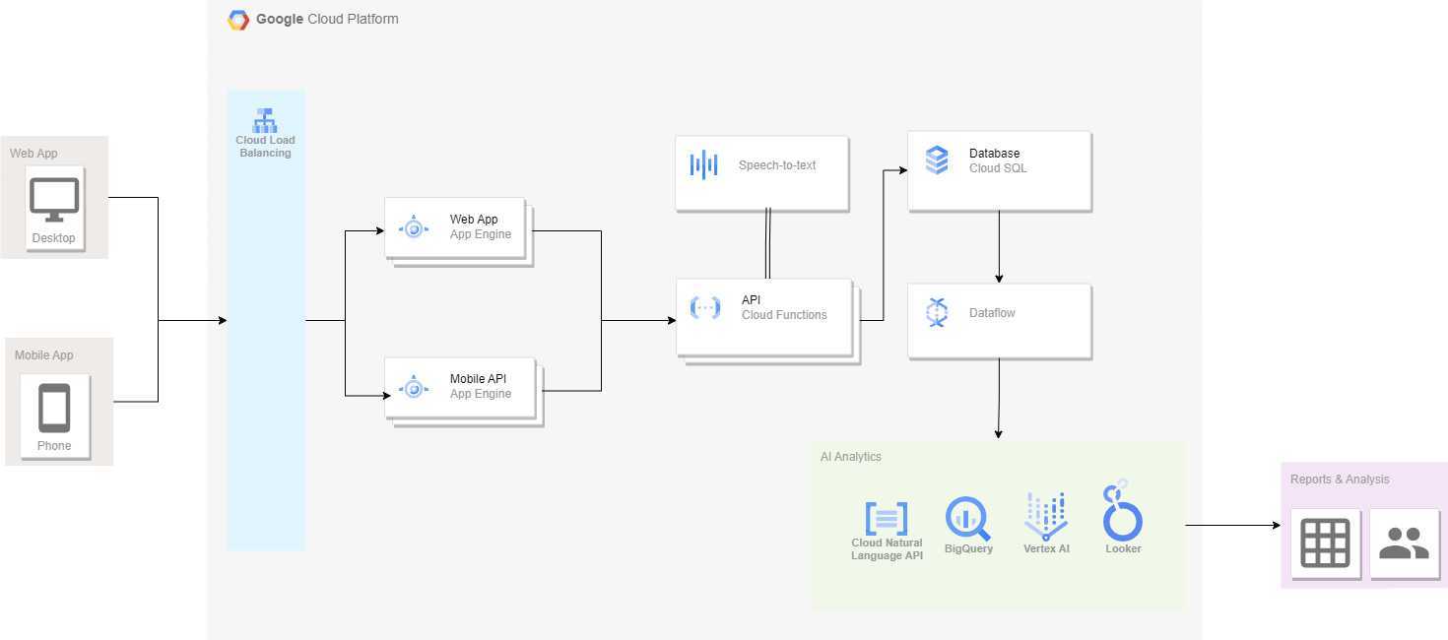
Architecture
SHOURYA

Slide 16
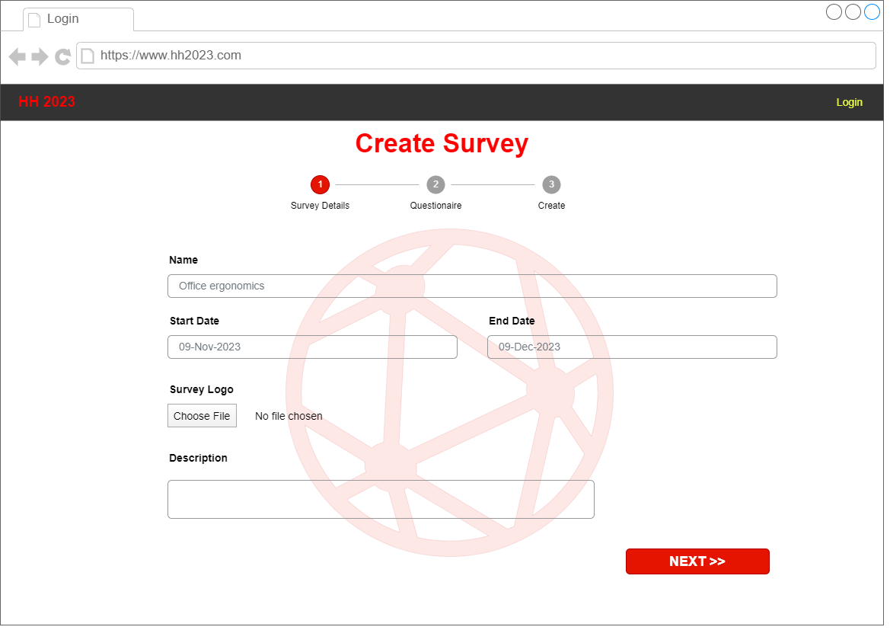
Demo
SHOURYA

Slide 17
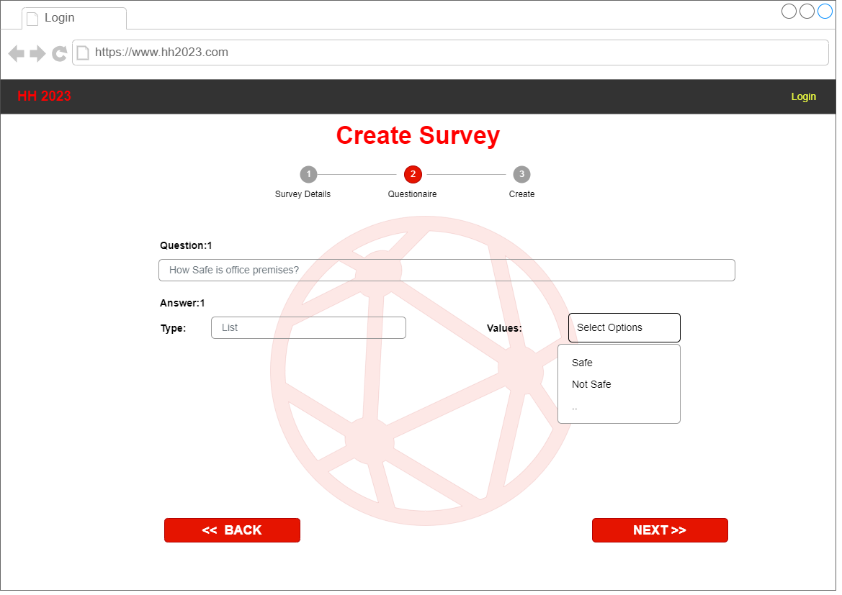
Demo
SHOURYA

Slide 18
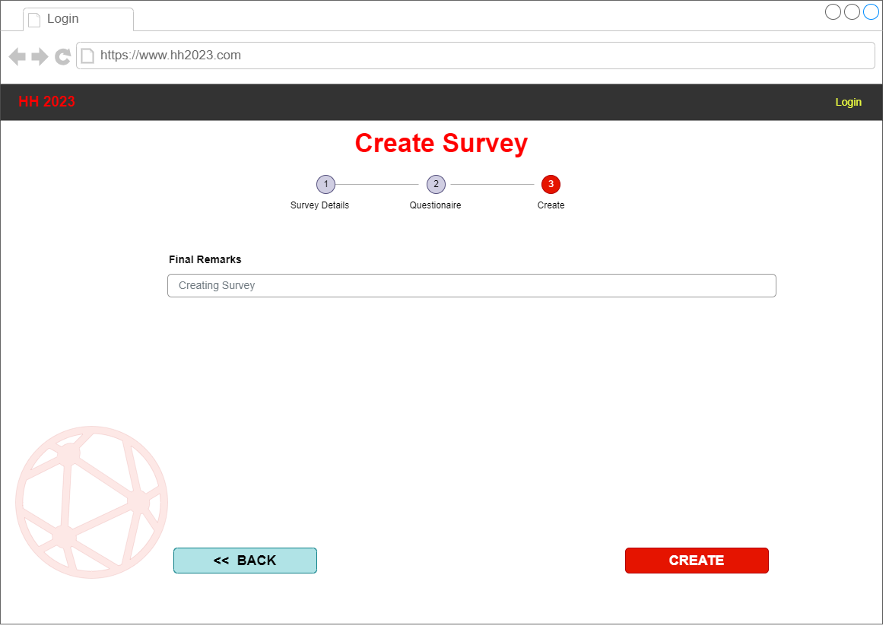
Demo
SHOURYA

Slide 19
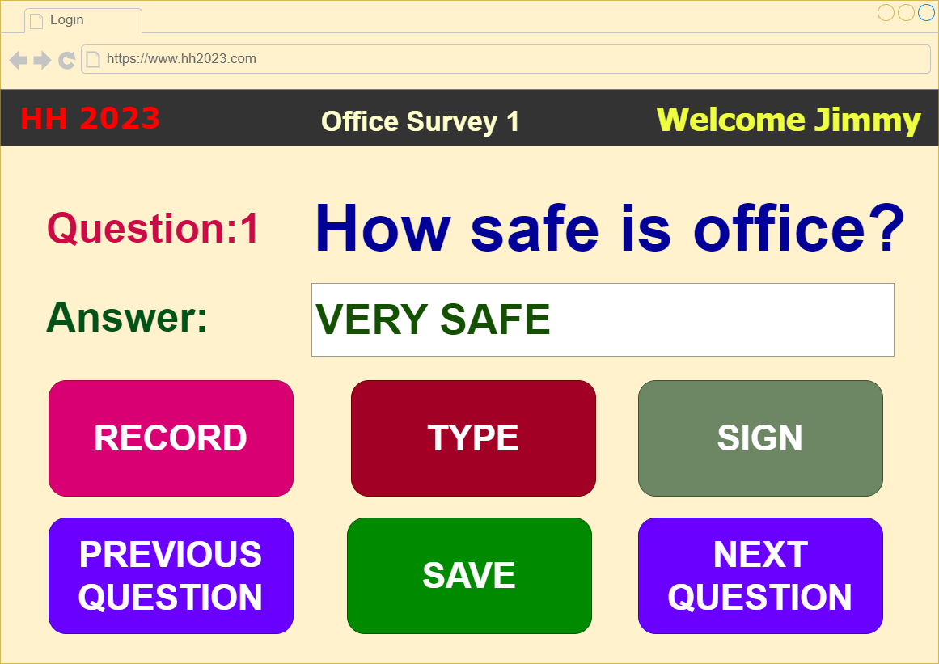
Demo
SHOURYA

Slide 20
SHOURYA
Future Improvements

Slide 21
Impact and Benefits
SHOURYA
Accessibility and Inclusivity: By designing a feedback form application that accommodates various disabilities, such as visual, auditory, motor, or cognitive impairments, it promotes inclusivity. Features like screen reader compatibility, voice commands, adjustable font sizes, and intuitive navigation make it accessible to a broader range of users.
Empowerment and Engagement: Offering a platform for disabled individuals to provide feedback empowers them to voice their opinions, concerns, and suggestions. This engagement fosters a sense of inclusion, enabling them to actively participate in discussions and decisions that affect them directly.
Improved User Experience: Tailoring the application to accommodate diverse needs enhances the overall user experience for all participants. The features and functionalities developed to assist disabled individuals often translate into a more user-friendly, intuitive interface for everyone.

Slide 22
SHOURYA
Thanks

